Slide 1
Inference of PGMs
Huijun Di
ajon@bit.edu.cn

Slide 2
Outline
Inference Problems
Inference Algorithms
Variable Elimination
Belief Propagation
Dynamic Programing
Approximate Inference as Minimizing Free Energies
ICM
EM
Variational techniques
Mean Field
Structured variational method
Belief Propagation
Annealing
Summary & Homework

Slide 3
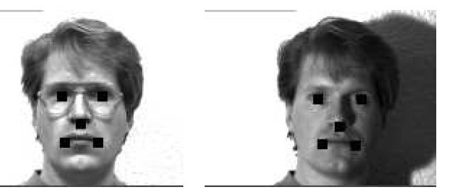







BN: Pictorial Structures
L₂
L₃
L₁
L₄
L₅
Z₂
Z₄
Z₁
Z₅
Z₃
Inference:

Slide 4

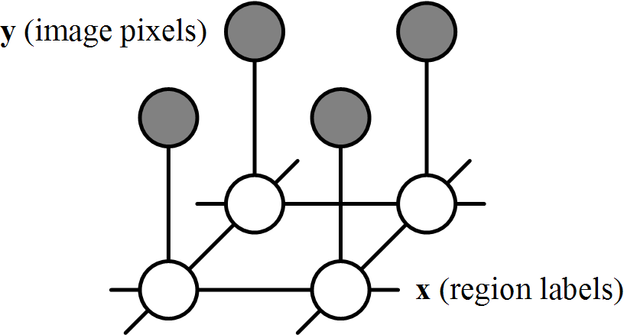

MRF
real image
1
label image
Inference: max Pr(x,y) ≡ min E(x)
Energy function:

Slide 5
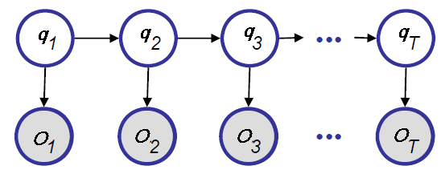


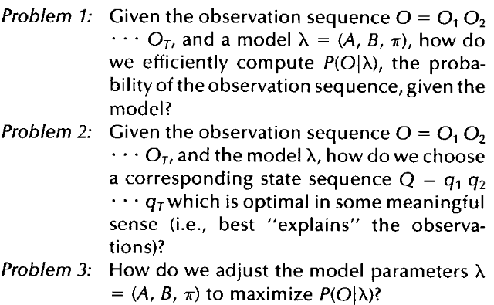

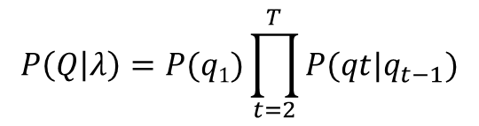

Hidden Markov Model (HMM)
Hidden state q_{t}
q_{t} ϵ {S₁, ..., S_{N}}
Observation O_{t}
O_{t} ϵ {V₁, ..., V_{M}}
Three basic problems of HMM:

Slide 6
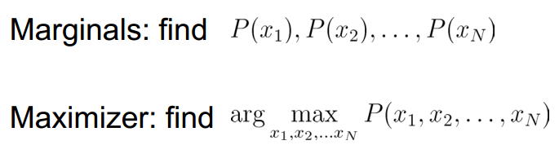

Marginals vs. maximizer
P(q_{i})

Slide 7
Outline
Inference Problems
Inference Algorithms
Variable Elimination
Belief Propagation
Dynamic Programing
Approximate Inference as Minimizing Free Energies
ICM
EM
Variational techniques
Mean Field
Structured variational method
Belief Propagation
Annealing
Summary & Homework

Slide 8
Inference Algorithms
Exact Inference
Enumeration
Variable Elimination
Tree structure: Belief Propagation, Dynamic Programing
Junction Trees
Graph cut: MRF (two labels)
etc.
Approximate Inference
Loopy belief propagation
Graph cut: MRF (more than two labels)
Sampling methods
Variational approximation
etc.

Slide 9
Outline
Inference Problems
Inference Algorithms
Variable Elimination
Belief Propagation
Dynamic Programing
Approximate Inference as Minimizing Free Energies
ICM
EM
Variational techniques
Mean Field
Structured variational method
Belief Propagation
Annealing
Summary & Homework

Slide 10
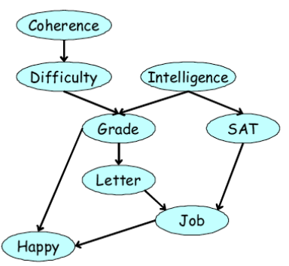
Variable Elimination
What is p(Job)?

Slide 11
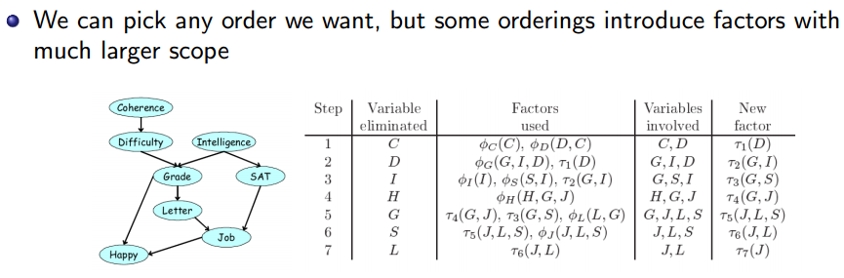
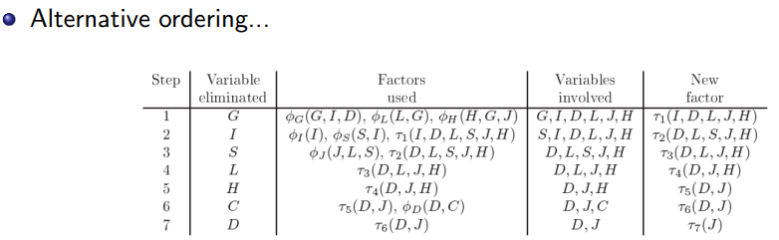
Elimination ordering

Slide 12
Variable Elimination
Can only calculate one marginal at a time
P(J)
If we want to calculate all the marginals in PGM
P(C), P(D), P(I), P(G), P(S), P(L), P(H), P(J)
how?
Belief Propagation

Slide 13
Outline
Inference Problems
Inference Algorithms
Variable Elimination
Belief Propagation
Dynamic Programing
Approximate Inference as Minimizing Free Energies
ICM
EM
Variational techniques
Mean Field
Structured variational method
Belief Propagation
Annealing
Summary & Homework

Slide 14
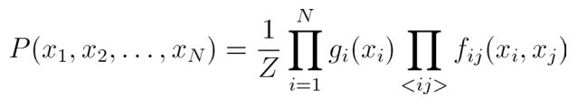
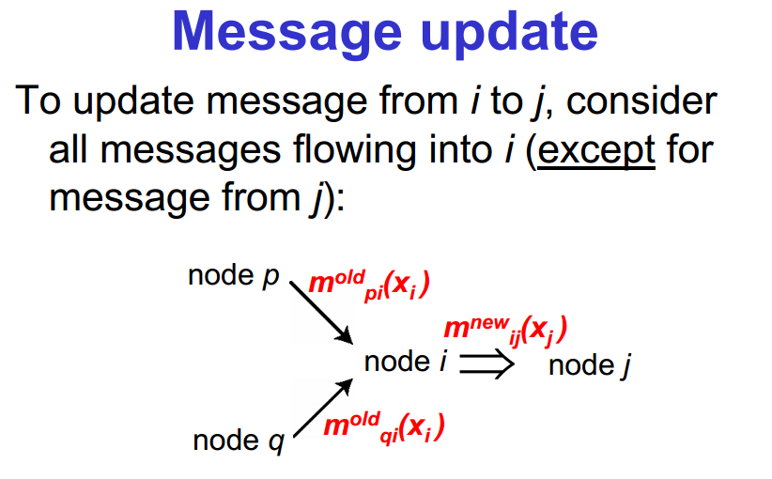
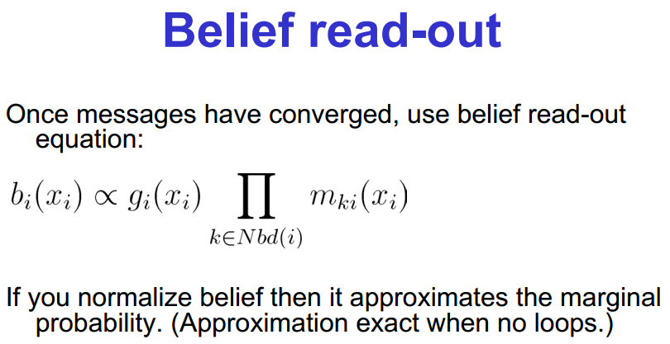
Belief Propagation
Update schedule
For a chain/Tree: up and down chain once guarantees convergence
For a grid (e.g. stereo on pixel lattice): people often sweep in an “up-down-left-right fashion”
m₁₂(q₂)
m₂₃(q₃)
m₃₄(q₄)
q₁
q₂
q₃
q₄
m₂₁(q₁)
m₃₂(q₂)
m₄₃(q₃)

Slide 15
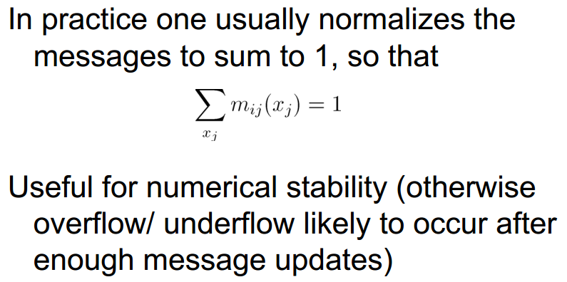

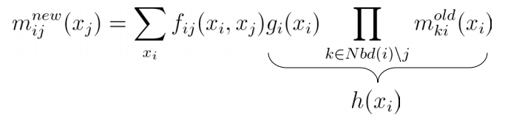
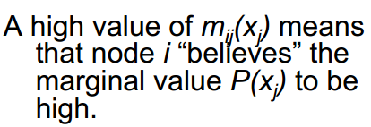
Belief Propagation
m₁₂(q₂)
m₂₃(q₃)
m₃₄(q₄)
q₁
q₂
q₃
q₄
m₂₁(q₁)
m₃₂(q₂)
m₄₃(q₃)

Slide 16
Belief Propagation
f
g
m₁₂(q₂)
m₂₃(q₃)
m₃₄(q₄)
q₁
q₂
q₃
q₄
m₂₁(q₁)
m₃₂(q₂)
m₄₃(q₃)

Slide 17
Outline
Inference Problems
Inference Algorithms
Variable Elimination
Belief Propagation
Dynamic Programing
Approximate Inference as Minimizing Free Energies
ICM
EM
Variational techniques
Mean Field
Structured variational method
Belief Propagation
Annealing
Summary & Homework

Slide 18
Dynamic Programing
Belief Propagation
Any structure
Dynamic Programing
Chain/Tree
m₁₂(q₂)
m₂₃(q₃)
m₃₄(q₄)
q₁
q₂
q₃
q₄
m₂₁(q₁)
m₃₂(q₂)
m₄₃(q₃)
Chain/Tree
P(q₁|q₂)
P(q₂|q₃)
P(q₃|q₄)
m₁₂(q₂)
m₂₃(q₃)
m₃₄(q₄)
q₁
q₂
q₃
q₄
P(q₁)
P(q₂)
P(q₃)
P(q₄)

Slide 19
Outline
Inference Problems
Inference Algorithms
Variable Elimination
Belief Propagation
Dynamic Programing
Approximate Inference as Minimizing Free Energies
ICM
EM
Variational techniques
Mean Field
Structured variational method
Belief Propagation
Annealing
Summary & Homework

Slide 20
Approximate Inference as Minimizing Free Energies
h≡(q,λ)
Our goal: to obtain P(h|v)
max_{h} P(h|v)
E_{P(h|v)}( f(h) )
Usually, the exact posterior is intractable
The idea of approximation
Approximate the true posterior distribution P(h|v) by a simpler distribution Q(h)
Goal: find the Q(h) which can best approximate P(h|v)
Q(h) is then used for making decisions, computing estimates, summarizing the data
max_{h} Q(h)
E_{Q(h)}( f(h) )
v ≡(o)

Slide 21





Approximate Inference as Minimizing Free Energies
To measure of similarity between the two distributions
need a cost function
Kullback-Leibler divergence
iif

Slide 22
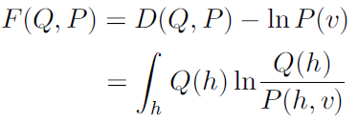
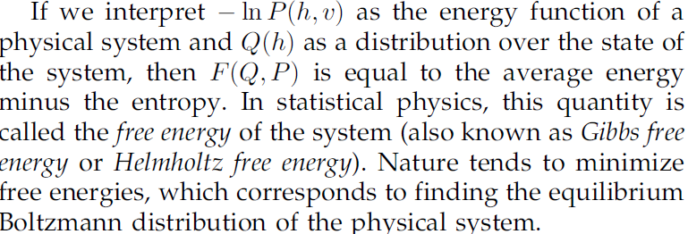
Approximate Inference as Minimizing Free Energies
Free energy
Inference/learning (a unified view)
Design a special simplified form of Q(h): lead to different algorithm
min_{Q} F(Q,P)

Slide 23

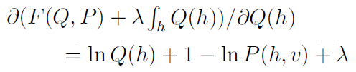

Approximate Inference as Minimizing Free Energies
Exact inference
If do not assume any simplified form of Q(h)
min_{Q} F(Q,P)
s.t.
=0

Slide 24
Outline
Inference Problems
Inference Algorithms
Variable Elimination
Belief Propagation
Dynamic Programing
Approximate Inference as Minimizing Free Energies
ICM
EM
Variational techniques
Mean Field
Structured variational method
Belief Propagation
Annealing
Summary & Homework

Slide 25
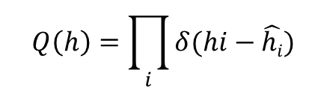
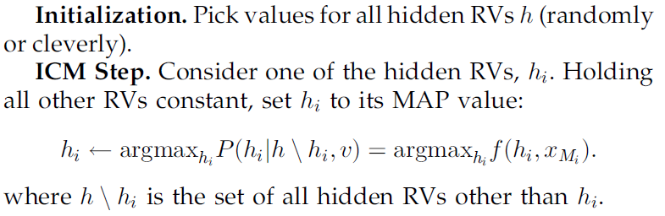
Iterated Conditional Modes (ICM)
Point estimates
Let us do the equations: GMM
The best-known example of ICM is k-means clustering
hidden random varibales (RVs) h: cluster centers and the class labels

Slide 26

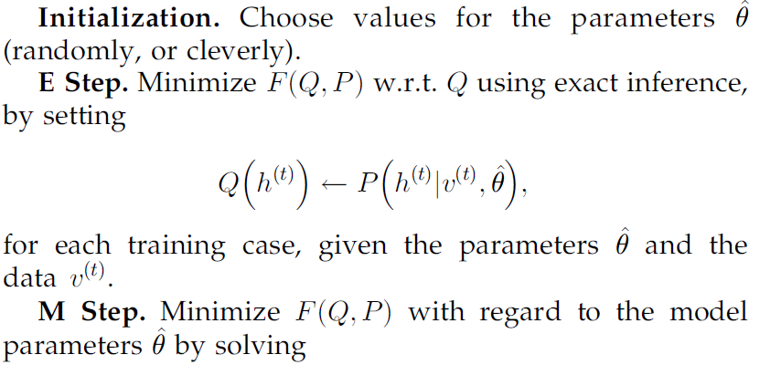
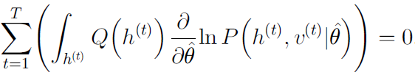
Expectation-Maximization (EM) Algorithm
Let us do the equations: GMM
h=(θ, h_{other})
EM obtains point estimates for θ and computes the exact posterior over the other RVs, given θ

Slide 27
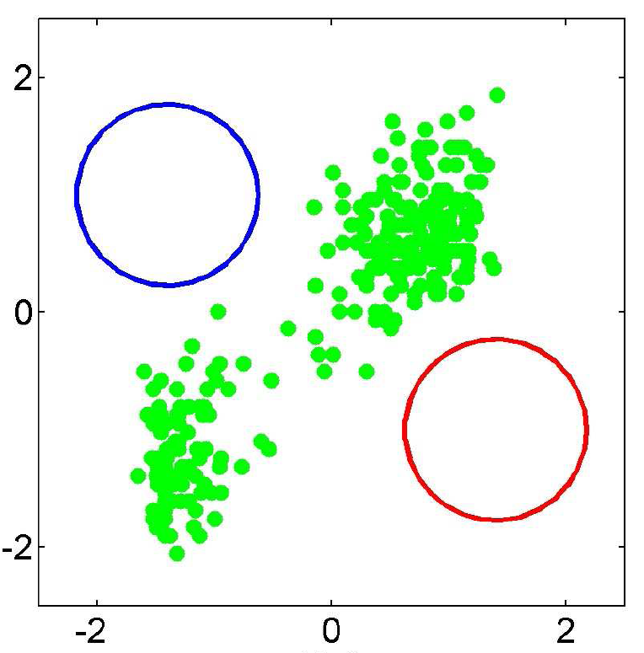
GMM: EM
Initialization

Slide 28
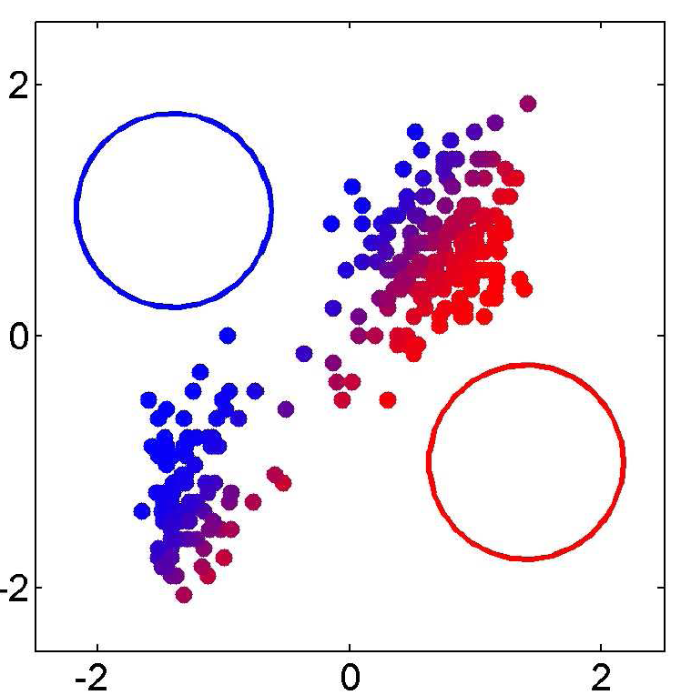
GMM: EM
Iter 1: prob

Slide 29
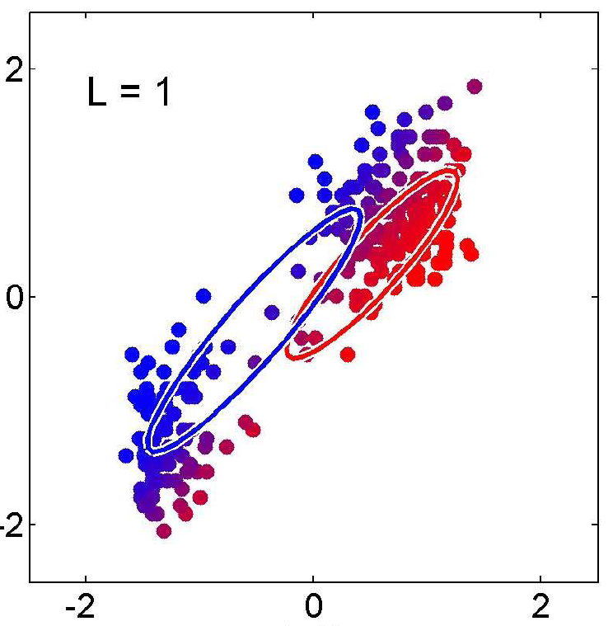
GMM: EM
Iter 1: estimate the parameters

Slide 30
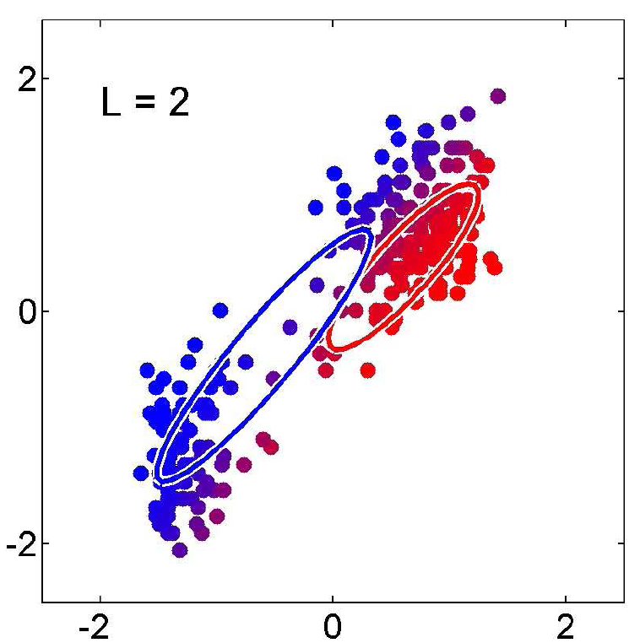
GMM: EM
Iter 2

Slide 31
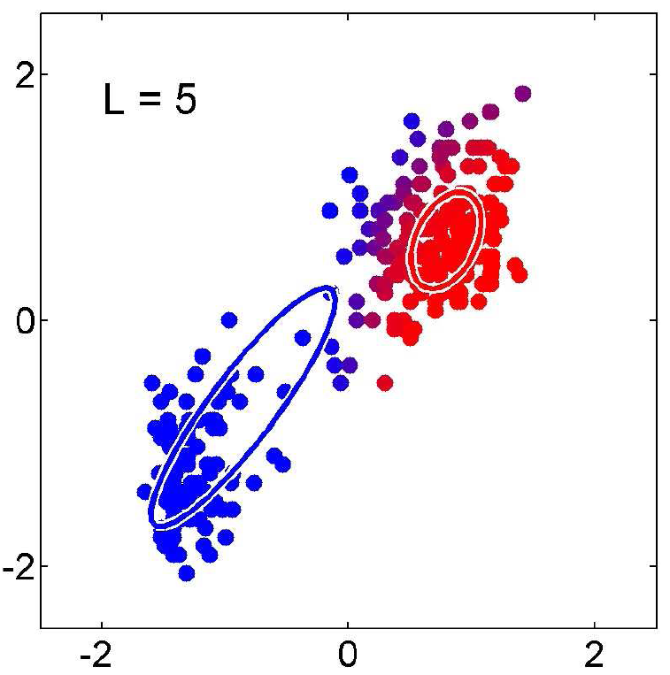
GMM: EM
Iter 5

Slide 32
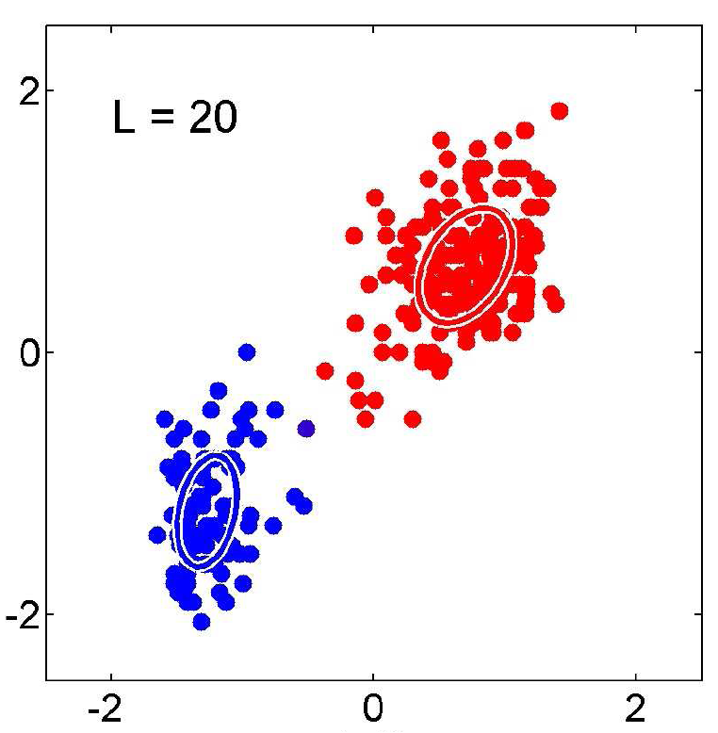
GMM: EM
Iter 20

Slide 33
Outline
Inference Problems
Inference Algorithms
Variable Elimination
Belief Propagation
Dynamic Programing
Approximate Inference as Minimizing Free Energies
ICM
EM
Variational techniques
Mean Field
Structured variational method
Belief Propagation
Annealing
Summary & Homework

Slide 34
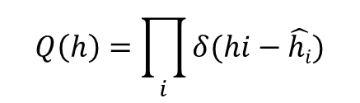

Variational techniques
ICM
Point estimation
Do not account for uncertainty
EM
exact EM is often not possible because the exact posterior is intractable.
Also, exact EM does not account for uncertainty in the parameters
Variational techniques
Assume that Q(h) comes from a restricted family of distributions that can be efficiently searched over

Slide 35
Variational techniques
Mean Field
Structured variational method
Belief Propagation

Slide 36

Mean Field
Product form (fully factorized) Q-distribution
Discrete RV: Q(h_{i}) is a vector
Continuous RV: Q(h_{i}) a parametric distribution
e.g., Gaussion Q(h_{i}|μ,Σ)

Slide 37
Variational techniques
Mean Field
Structured variational method
Belief Propagation

Slide 38
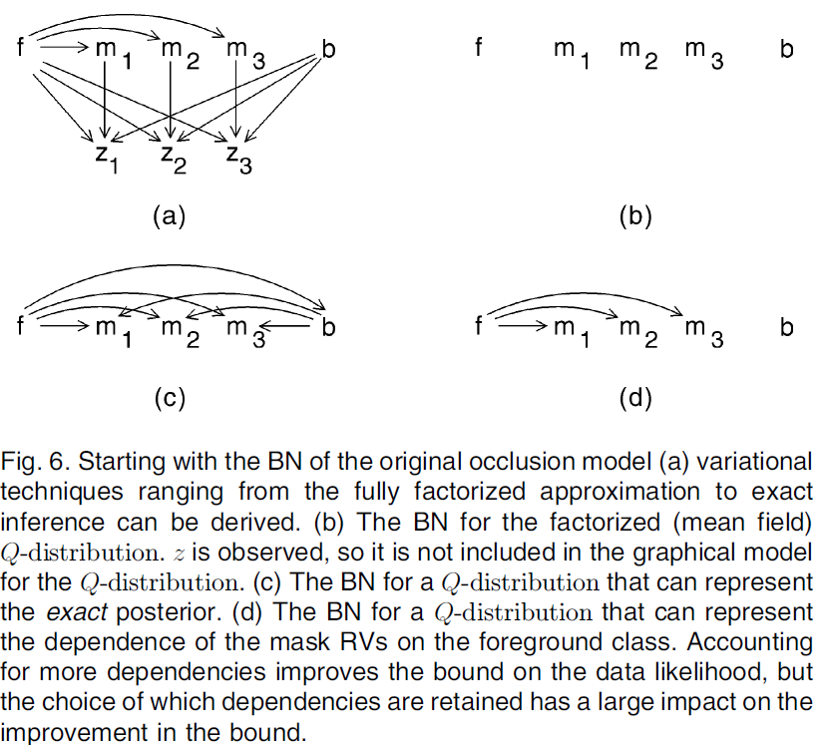

Structured variational method
Mean field
Structured variational method

Slide 39

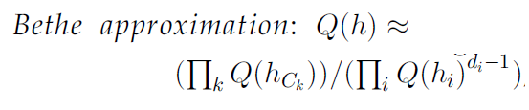
Variational techniques
Mean Field
Structured variational method
Belief Propagation

Slide 40
Outline
Inference Problems
Inference Algorithms
Variable Elimination
Belief Propagation
Dynamic Programing
Approximate Inference as Minimizing Free Energies
ICM
EM
Variational techniques
Mean Field
Structured variational method
Belief Propagation
Annealing
Summary & Homework

Slide 41
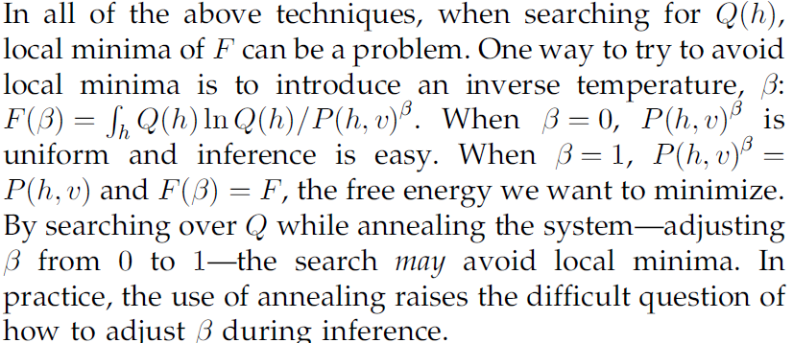
Annealing

Slide 42
Outline
Inference Problems
Inference Algorithms
Variable Elimination
Belief Propagation
Dynamic Programing
Approximate Inference as Minimizing Free Energies
ICM
EM
Variational techniques
Mean Field
Structured variational method
Belief Propagation
Annealing
Summary & Homework

Slide 43
Summary
Dependencies: combinatorial search
Takes advantage of the graph structure
Variable Elimination, Belief Propagation, Dynamic Programing
Approximation
balance between complexity and accuracy
(ICM, Mean field) → (Structured variational method, BP) → EM
Uncertainties: a neighbor may be untrustworthy
try to maintain distributions for RV, rather than point estimations
ICM → EM → (Mean field/Structured variational method, BP)

Slide 44
Homework and projects
My Parts
T1: Translate one paper
Pedro Domingos, A Few Useful Things to Know about Machine Learning
T2: Do the math practice
Inference of a PGM
T3: One project
EM
Submission
submit via email: ajon@bit.edu.cn
deadline: 2016.2.1

Slide 45

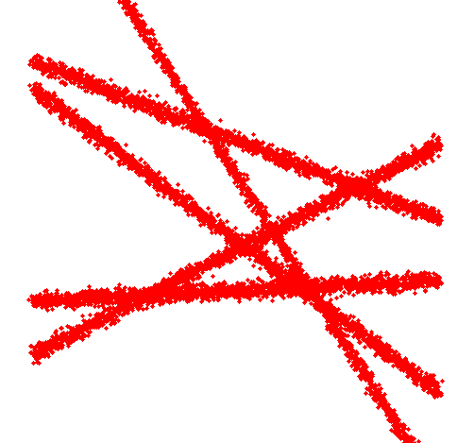

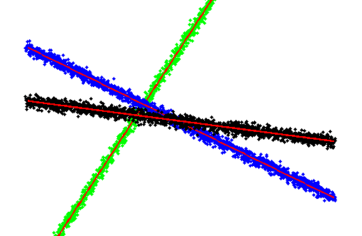
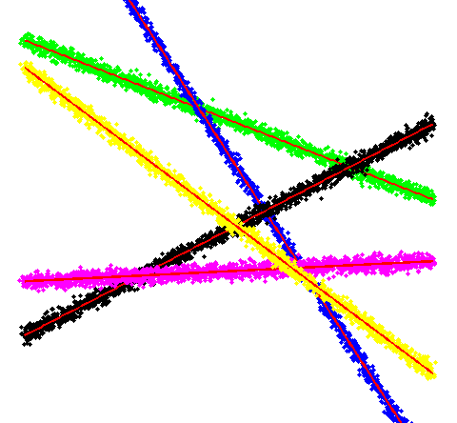
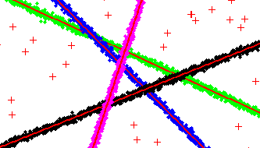
Problem for T2&T3
Co-fitting of Multiple Lines

Slide 46
Your Task
Co-fitting of Multiple Lines
T2: Do the math practice
Write out the PGM
JPDF
Objective Function
Inference Algorithm based on EM (with detailed update equations)
T3: One project
Implement the EM Algorithm
Test it on the data generated by genLineData.m

Slide 47
genLineData.m
sx = 100;
sy = 50;
xVec = -sx:sx;
yVec = -sy:sy;
numLine = 4;
sigma = 10*rand(1)+1;
numPert = 10;
noise = 1;
noiseLevel = 0.01;
figure;
subplot(121);
hold on;
cVec = 'gbkmyc';
linePara = zeros(numLine, 3);
dataAll = [];
pt1 = [(rand(1)-0.5)*sx, (rand(1)-0.5)*sy];
for i = 1:numLine
pt2 = [(rand(1)-0.5)*sx, (rand(1)-0.5)*sy];
LPT = [pt1; pt2];
coeff = princomp(LPT);
normal = coeff(:,2);
p = [normal(1), normal(2), -mean(LPT,1)*normal];
linePara(i, :) = p;
if p(1) > p(2)
xx = -(yVec*p(2) + p(3))/p(1);
yy = yVec;
else
xx = xVec;
yy = -(xVec*p(1) + p(3))/p(2);
end
numPt = length(xx);
dxx = repmat(xx, numPert, 1) + randn(numPert, numPt);
dyy = repmat(yy, numPert, 1) + randn(numPert, numPt);
dpt = [dxx(:), dyy(:)];
dataAll = [dataAll; dpt];
plot(dpt(:,1), dpt(:,2), ['.' cVec(mod(i-1, length(cVec))+1)]);
plot(xx, yy, 'r', 'lineWidth', 2);
pt1 = pt2;
end
if noise
m = round(size(dataAll, 1)*noiseLevel) + 1;
nPt = [(rand(m, 1)-0.5)*sx*2, (rand(m, 1)-0.5)*sy*2];
for i = 1:numLine
m = size(nPt, 1);
dist = abs(sum(repmat(linePara(i,1:2), m, 1).*nPt,2) + repmat(linePara(i,3), m, 1));
nPt(dist < sigma, :) = [];
end
plot(nPt(:,1), nPt(:,2), '+r');
dataAll = [dataAll; nPt];
end
axis equal;
subplot(122);
hold on;
plot(dataAll(:,1), dataAll(:,2), 'r.');
axis equal;

